Slide 1
Canvas2D 2D Graphics

Slide 2
HTML5 Canvas? (1/2)
The HTML5 Canvas is an Immediate Mode bit-mapped area of the screen that can be manipulated with JavaScript and CSS.
The HTML5 <canvas> element is used to draw graphics, on the fly, via scripting (usually JavaScript).
The <canvas> element is only a container for graphics. You must use a script to actually draw the graphics.
Canvas has several methods for drawing paths, boxes, circles, characters, and adding images.

Slide 3
HTML5 Canvas? (2/2)
Features
2D Context
Save, Restore : push or pop graphics state stack
Transformation
Global alpha
Shapes : Fill and Stroke Path
Canvas State : Fill and Stroke Style, Matrix, Clipping region…
Image
Text
Hardware Accelerated Canvas Element

Slide 4
Flash vs Canvas
Finished Essential guide To Flash Games in March 2010.
Steve Jobs refused Flash on the iOS just days later.
Easy Tools: a web browser, text editor and JavaScript was all that was required.
The HTML5 Canvas allowed for a bitmapped graphics, much Flash’s bitmapped canvas.
Our specific Type Of Game Development translates well (tile sheets, bitmaps)

Slide 5
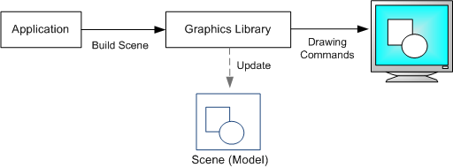
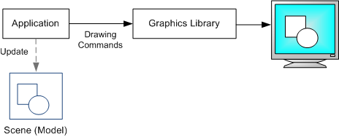
Retained mode vs Immediate
Fig1. Retained Mode
Fig2. Immediate Mode

Slide 6
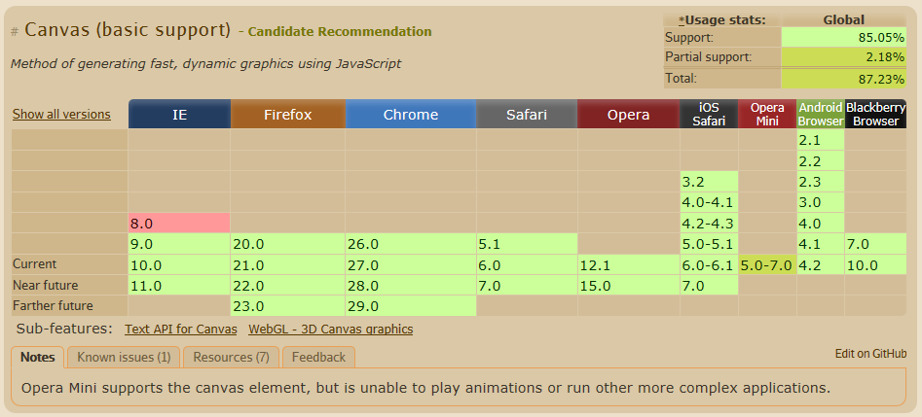
HTML5 Canvas Support

Slide 7
HTML5 Canvas properties & methods
width
height
id
<canvas id=“MyFirstCanvas” width=“600” heght=“200”>
This text is displayed if your browser does not support HTML5 Canvas.
</canvas>

Slide 8
Colors, Styles, and Shadows
Property | Description
fillStyle | Sets or returns the color, gradient, or pattern used to fill the drawing
strokeStyle | Sets or returns the color, gradient, or pattern used for strokes
shadowColor | Sets or returns the color to use for shadows
shadowBlur | Sets or returns the blur level for shadows
shadowOffsetX | Sets or returns the horizontal distance of the shadow from the shape
shadowOffsetY | Sets or returns the vertical distance of the shadow from the shape
Method | Description
createLinearGradient() | Creates a linear gradient (to use on canvas content)
createPattern() | Repeats a specified element in the specified direction
createRadialGradient() | Creates a radial/circular gradient (to use on canvas content)
addColorStop() | Specifies the colors and stop positions in a gradient object

Slide 9
Rectangles
Method | Description
rect() | Creates a rectangle
fillRect() | Draws a "filled" rectangle
strokeRect() | Draws a rectangle (no fill)
clearRect() | Clears the specified pixels within a given rectangle

Slide 10
Line Styles
Property | Description
lineCap | Sets or returns the style of the end caps for a line
lineJoin | Sets or returns the type of corner created, when two lines meet
lineWidth | Sets or returns the current line width
miterLimit | Sets or returns the maximum miter length

Slide 11
Paths
Method | Description
fill() | Fills the current drawing (path)
stroke() | Actually draws the path you have defined
beginPath() | Begins a path, or resets the current path
moveTo() | Moves the path to the specified point in the canvas, without creating a line
closePath() | Creates a path from the current point back to the starting point
lineTo() | Adds a new point and creates a line from that point to the last specified point in the canvas
clip() | Clips a region of any shape and size from the original canvas
quadraticCurveTo() | Creates a quadratic Bézier curve
bezierCurveTo() | Creates a cubic Bézier curve
arc() | Creates an arc/curve (used to create circles, or parts of circles)
arcTo() | Creates an arc/curve between two tangents
isPointInPath() | Returns true if the specified point is in the current path, otherwise false

Slide 12
Transformations
Method | Description
scale() | Scales the current drawing bigger or smaller
rotate() | Rotates the current drawing
translate() | Remaps the (0,0) position on the canvas
transform() | Replaces the current transformation matrix for the drawing
setTransform() | Resets the current transform to the identity matrix. Then runs transform()

Slide 13
Text
Property | Description
font | Sets or returns the current font properties for text content
textAlign | Sets or returns the current alignment for text content
textBaseline | Sets or returns the current text baseline used when drawing text
Method | Description
fillText() | Draws "filled" text on the canvas
strokeText() | Draws text on the canvas (no fill)
measureText() | Returns an object that contains the width of the specified text

Slide 14
Images
Method | Description
drawImage() | Draws an image, canvas, or video onto the canvas
Property | Description
width | Returns the width of an ImageData object
height | Returns the height of an ImageData object
data | Returns an object that contains image data of a specified ImageData object
Method | Description
createImageData() | Creates a new, blank ImageData object
getImageData() | Returns an ImageData object that copies the pixel data for the specified rectangle on a canvas
putImageData() | Puts the image data (from a specified ImageData object) back onto the canvas

Slide 15
Compositing & Others
Property | Description
globalAlpha | Sets or returns the current alpha or transparency value of the drawing
globalCompositeOperation | Sets or returns how a new image are drawn onto an existing image
Method | Description
save() | Saves the state of the current context
restore() | Returns previously saved path state and attributes
createEvent()
getContext()
toDataURL()

Slide 16
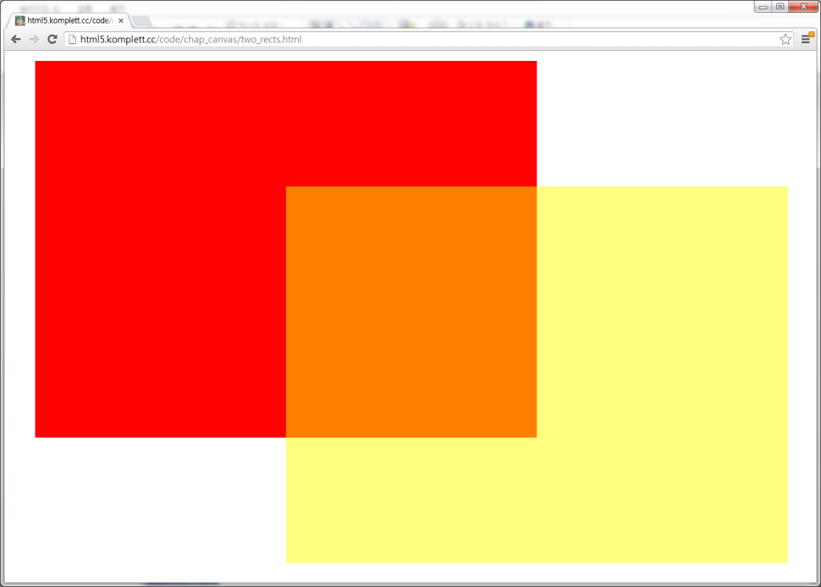
Example : Two overlapped rectanges
<script>
var canvas = document.querySelector("canvas");
var context = canvas.getContext('2d');
context.fillStyle = 'red';
context.fillRect(0,0,800,600);
context.fillStyle = 'rgba(255,255,0,0.5)';
context.fillRect(400,200,800,600);
</script>

Slide 17
Example : Curve
<script>
var canvas = document.querySelector("canvas");
var context = canvas.getContext('2d');
…………………….
// geometry
context.save();
context.beginPath();
context.moveTo(20,130);
context.quadraticCurveTo(20,20,130,20);
context.strokeStyle = colors.path;
context.stroke();
context.restore();
…………………….
</script>

Slide 18
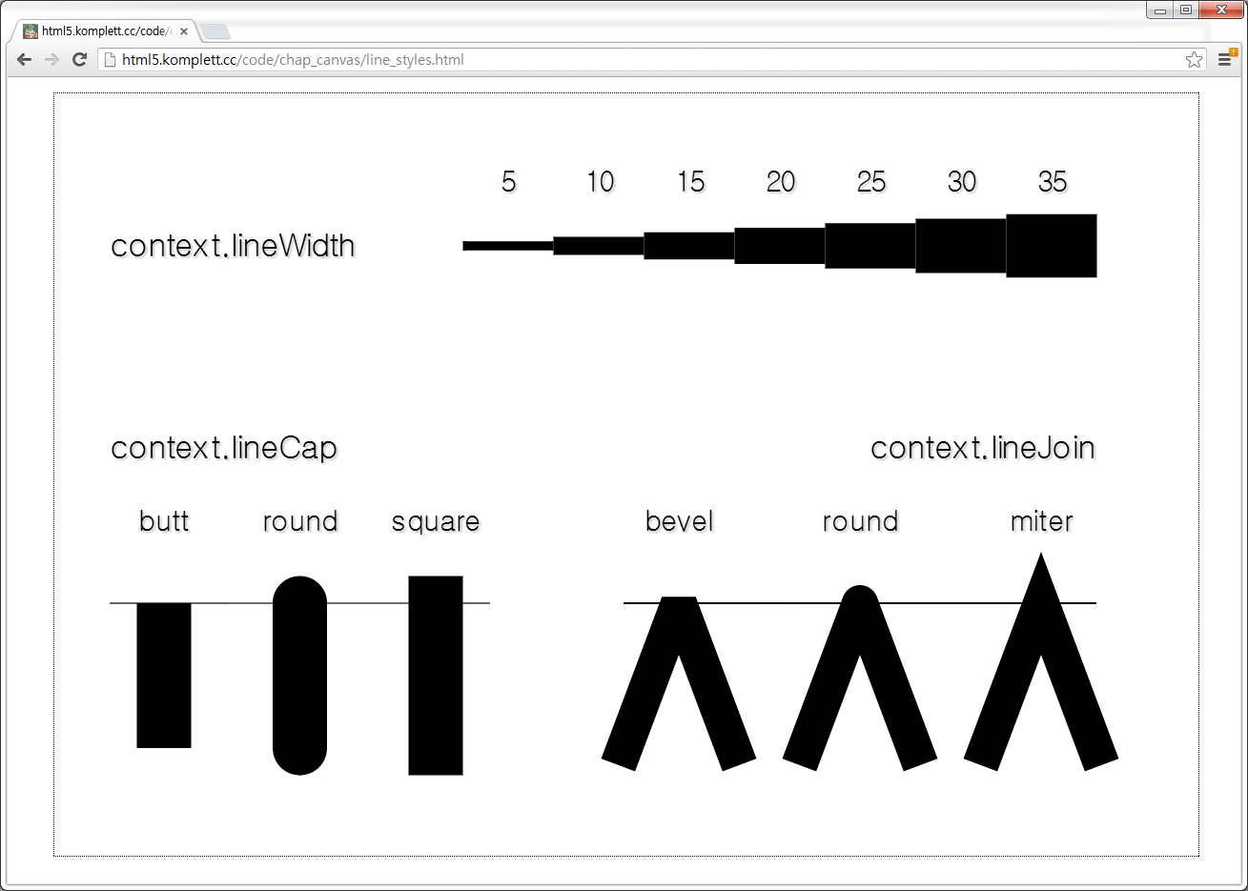
Example : Stroke
<script>
var canvas = document.querySelector("canvas");
var context = canvas.getContext('2d');
…………………….
// thick line
context.lineWidth = 20.0;
// join style
context.beginPath();
context.lineJoin = 'bevel';
context.lineJoin = 'round';
context.lineJoin = 'miter';
context.moveTo(20,130);
context.lineTo(50,50);
context.lineTo(80,130);
context.stroke();
…………………….
// cap style
context.beginPath();
context.lineCap = 'butt';
context.lineCap = 'round';
context.lineCap = 'square';
context.moveTo(50,130);
context.lineTo(50,50);
context.stroke();
…………………….
</script>

Slide 19
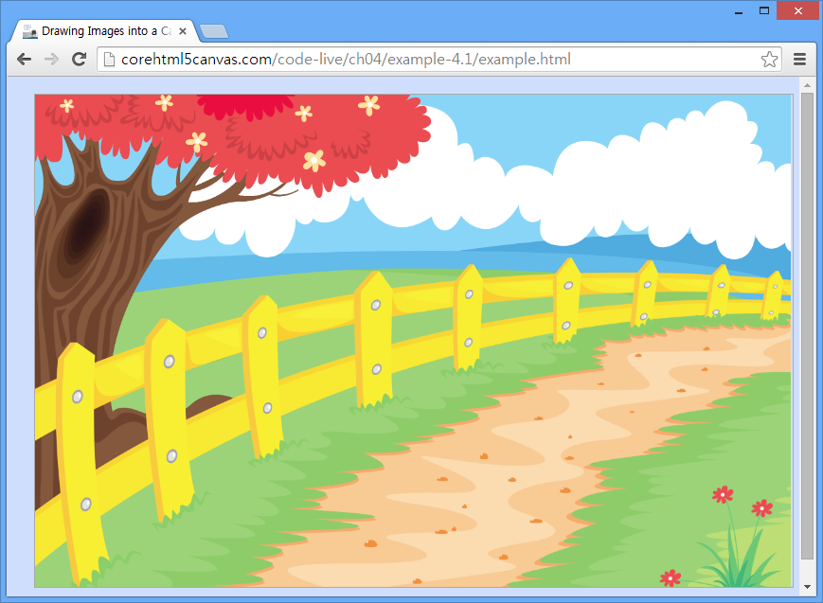
Example : Image
<script>
var canvas = document.getElementById('canvas'),
context = canvas.getContext('2d'),
image = new Image();
image.src = '../../shared/images/countrypath.jpg';
image.onload = function(e) {
context.drawImage(image, 0, 0);
};
</script>

Slide 20
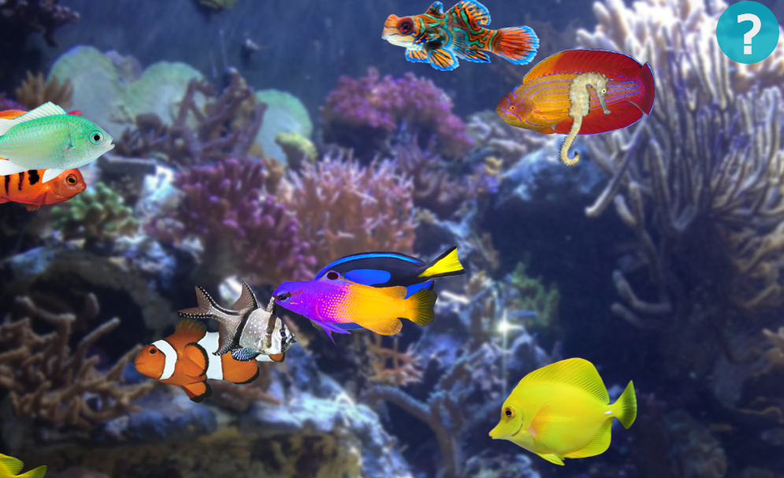
Canvas Demo
http://www.upstreamdown.com/fishtank/

Slide 21
References - Canvas
Web sites
http://diveintohtml5.org/canvas.html
https://developer.mozilla.org/en/Canvas_tutorial
http://www.whatwg.org/specs/web-apps/current-work/multipage/the-canvas-element.html
http://www.html5canvastutorials.com
http://www.w3schools.com
http://kineticjs.com/
Books
HTML5: Guidelines for Web Developers by Klaus Förster and Bernd Öggl
HTML5 Canvas by Steve Fulton, Jeff Fulton

